Slide 1




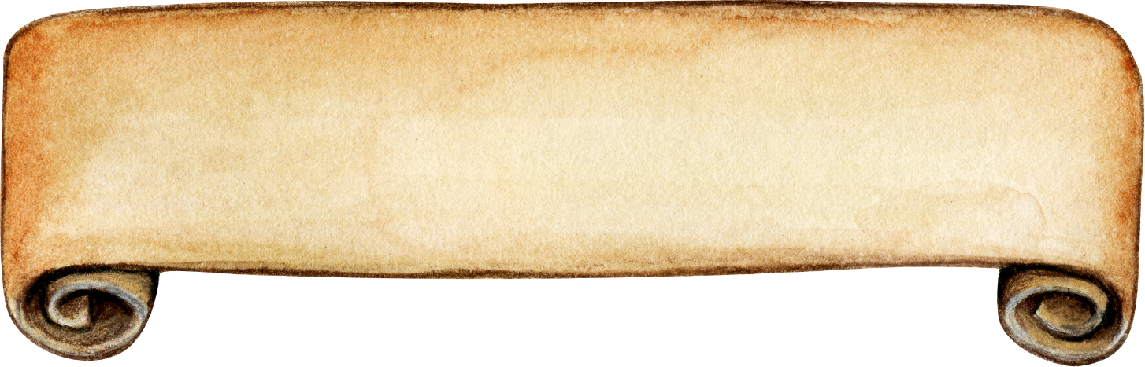
Good job!
Continue

